Slide 1
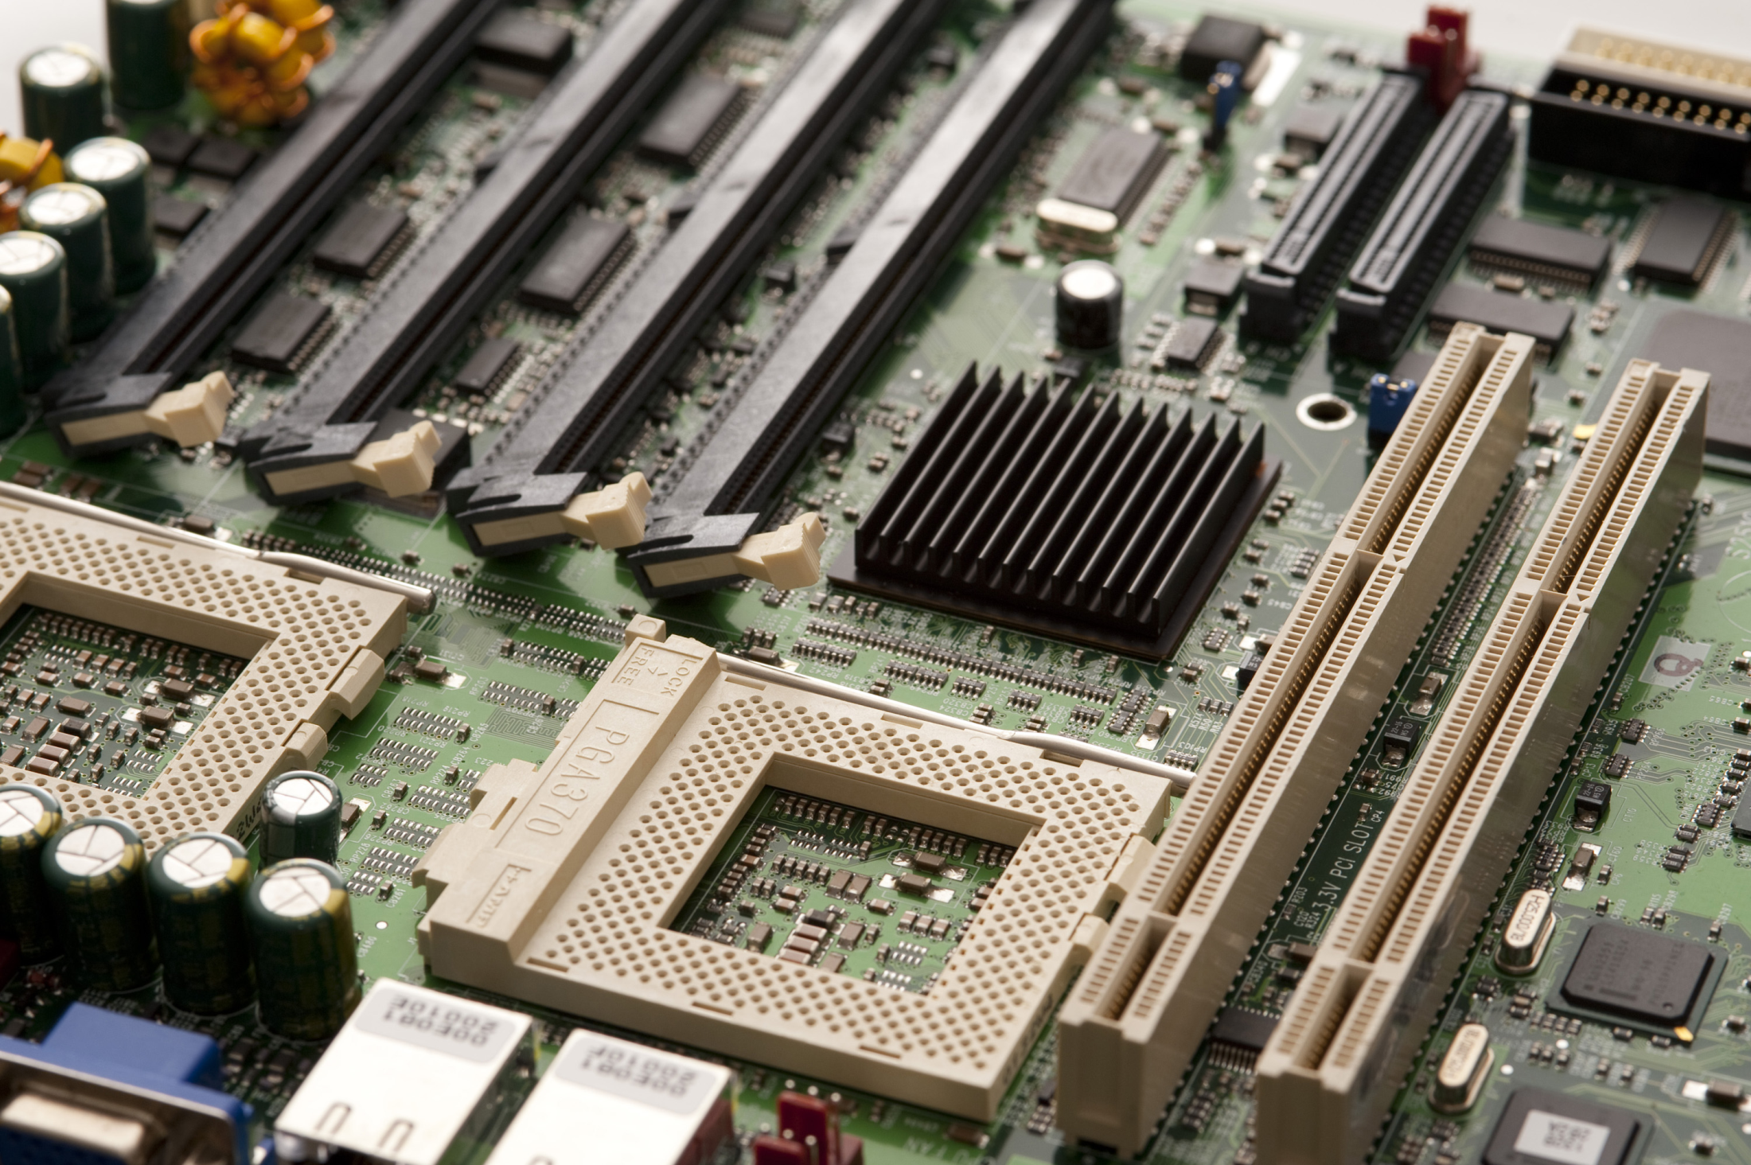
SC1006
Computer Organization and Architecture
Semiconductor Memories

Slide 2
**Which of the following memory are volatile in nature?
Magnetic HDD
SRAM
DRAM
EEPROM
NOR Flash

Slide 3
**Which of the following memory devices are non-volatile?
Magnetic HDD
Dynamic RAM
Static RAM
EEPROM
NAND Flash

Slide 4
**What is/are the effects of DRAM using single transistor cum capacitor design for storage?
Slower as memory needs to be refreshed
Simpler interface design as less transistors are used
Smaller layout compared to SRAM as less number of transistors are used
Larger layout compared to SRAM as capacitor occupies a larger area compared to transistors
Less transistors doesn’t imply simpler interface design.
DRAM requires more periodic refresh to maintain its data integrity, hence the interface controller has to include such refresh operation on top of the usual data transfer operation.
The larger number of transistors required to build one SRAM memory bit cell result in larger layout (area) needed compared to the DRAM, which only need one transistor + capacitor.

Slide 5
**What is/are the difference between SRAM and DRAM if both use same process technology?
SRAM is faster than DRAM
DRAM is faster than SRAM
SRAM has a larger layout than DRAM
SRAM uses capacitor as a storage element
DRAM requires periodic refresh to keep its data integrity
Using same process technology means the transistor will be of similar size and speed.
[A] and [C] is a direct result of the SRAM/DRAM design.
[E] is an operation required to maintain data integrity of DRAM. SRAM design doesn’t use capacitor so doesn’t suffer from natural leakage of electrical charges, hence no need for any periodic refresh overhead operation.

Slide 6
Why does DRAM require constant refresh operation to keep its data integrity?
DRAM is a type of volatile memory
DRAM uses capacitor as its storage element
DRAM uses less transistors compared to SRAM so less function build in
DRAM is slower than SRAM so needs to periodically refresh its content
The charged capacitor in DRAM design has a natural leakage path to ground, so charges is lost over time and data integrity is compromised.

Slide 7
What is the function of the pass transistor in the DRAM Design?
Store data
Control flow of charges to and from the capacitor
Control read/write operation mode
Logics to charge and discharge the capacitor
DRAM design consist of one transistor and a capacitor. The capacitor stores a Logic ‘1’ or ‘0’ based of whether they are charged or discharged. To test the state of the capacitor, it needs to be connected to the bit line, the path to the bit line is gated by a transistor know as the “Pass Transistor”. Check the lecture notes for graphical illustration.

Slide 8
What is the function of transistors in SRAM design?
Store Data
Control Read/Write mode
Store Data and Control logic for signal transfer between SRAM cells and internal data lines
Control logic for signal transfer between SRAM cells and internal data lines
SRAM design consist of six transistors. Four transistors implemented two NOT gates interlocked with each other, two transistors control to flow of charges in and out of the memory cell (the said two NOT gates).

Slide 9
**Difference between EEPROM and Flash?
Check the lecture notes for details on property of an EEPROM.
EEPROM is also based on Floating Gate Transistor but the design of the memory cells and the connection between the memory cells are different from Flash memory.
Flash erasure is faster when comparing erasing one block of Flash vs erasing equivalent size of data in EEPROM (consisting of multiple blocks since EERPOM page is smaller).
EEPROM has a higher cost per bit
Flash erasure is faster
EEPROM has a smaller page size
Flash has a smaller page size
Flash is available in larger capacity

Slide 10
Between NAND and NOR flash, which one has a higher cost per bit? Why?
NAND Flash. NAND gate is more complex than NOR gate.
NOR Flash. NOR gate is more complex than NAND gate.
NAND Flash. NAND flash layout has more wires, so more difficult to compact the layout.
NOR Flash. NOR flash layout has more wires, so more difficult to compact the layout.

Slide 11
Which Flash memory would you choose to build a 256GByte Solid-State Drive?
NOR Flash
NAND Flash
EEPROM
EPROM
NAND flash design result in lowest cost per bit compared to the other memory types listed here.

Slide 12
Which Non Volatile memory would you choose for the system memory of a processor system?
NOR Flash
NAND Flash
EEPROM
System memory is the memory where processor execute the program code directly during run time.
In order to support direct code execution, the memory needs to support Execute in Place (XIP).
Of the three memory types listed, only NOR flash supports XIP.

Slide 13
Which memory would you choose for the system memory of a smart phone ?
System memory of a smart phone runs a complex OS with many user applications.
Depending on what applications is required and the use case, these applications has to be loaded and removed from the system memory. A lot of data has to be read, modified and re-written back to the system memory.
The abundance of read/write operations means Flash memory is not suitable due to finite erase cycle limit.
Between DRAM and SRAM, DRAM is chosen as the amount of system memory required by smartphone OS (iOS or Android) requires Gbytes of memory. SRAM is too costly with such memory capacity.
Technically speaking, DRAM doesn’t support XIP as its interface is fairly complex. But processor which is able to interface to DRAM has a module that will enable code to be executed directly from DRAM. So DRAM is included as one of the candidate for System Memory in this course.
NOR Flash
NAND Flash
DRAM
SRAM

Slide 14
Which memory would you choose for the cache memory of a micro-processor?
NOR Flash
NAND Flash
DRAM
SRAM
Cache memory is a SMALL (Kbytes, Mbytes) and FAST memory used to boost the overall performance of a computer system.
A key requirement is FAST so SRAM is an ideal choice.
Since size is small so absolute cost increase is not as significant even if SRAM is used.
Non volatile memory is not suitable since there are a lot of read/write operations involved.

Slide 15
Which memory would you choose to store user configuration of a smart phone?
NAND Flash
DRAM
SRAM
User configuration needs to be retained when power is OFF.
NAND flash is the only non-volatile memory in the list.

Slide 16
What do we mean when we say a memory supports Execute-in-Place (XIP)? How does NOR flash support XIP?
XIP means that the code could be executed directly from the memory itself without having to transfer into the internal RAM. NOR flash supports XIP because the cells behaves like a NOR gate.
XIP means that the code could be executed directly from the memory itself without having to transfer into the internal RAM. NOR flash supports XIP because it allows random reading of its content with only address information supplied.
XIP means that data could be executed directly from the memory itself without having to transfer into the internal RAM. NOR flash supports XIP because it allow random reading of its content with only address information supplied.
XIP means that data could be executed directly from the memory itself without having to transfer into the internal RAM. NOR flash supports XIP because the cells behaves like a NOR gate.
The memory cells behaving like a NOR gate has nothing to do with NOR flash being XIP capable.
‘Data’ cannot be executed.
Only ‘Code’ can be executed.

